Slide 1



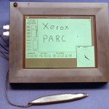
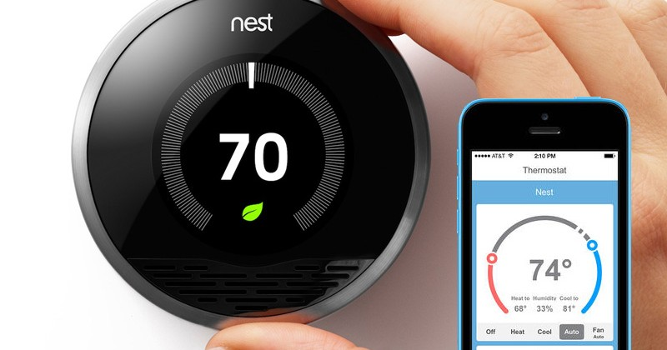
The Future of The Internet of Things (IoT)
The Beauty and Joy of Computing Lecture #3 Abstraction II
Jonathan
McKinsey
Started as Ubiquitous Computing coined by Mark Weisner in 1988.
Gaining more momentum as smartphones and tablets become more prevalent.
Current innovation tend to target private homes.
http://blogs.parc.com/files/2010/09/parcpad.jpg http://dailytechtrends.com/wp-content/uploads/2014/12/Internet-of-Things-Nest-Thermostat.jpg

Slide 2
Abstraction: Numbers

Slide 3
Abstraction: Numbers
000000100000000111011100001000000100011011011011011000000011001000100010001010001010000101110010000010000100000001111000
Number bases, including binary and decimal, are used for reasoning about digital data.
Bits represent binary data using base two digits: zero and one.
Hexadecimal, or base-16, is often used in reasoning about data e.g., colors in images.
Different bases help in reasoning about digital data; digital data is stored in bits.

Slide 4
Base 10 #s, Decimals
Digits: 0, 1, 2, 3, 4, 5, 6, 7, 8, 9
Example: 3271
3271₁₀ = (3x10³) + (2x10²) + (7x10¹) + (1x10⁰)

Slide 5
Base 2 #s, Binary (to Decimal)
Digits: 0, 1 (binary digits → bits)
Example: “1101” in binary? (“0b1101”)
1101₂ = (1x2³) + (1x2²) + (0x2¹) + (1x2⁰)
= 8 + 4 + 0 + 1
= 13

Slide 6
Base 16 #s, Hexadecimal (to Decimal)
Digits: 0, 1, 2, 3, 4, 5, 6, 7, 8, 9, A, B, C, D, E, F 10,11,12,13,14,15
Example: “A5” in Hexadecimal?
0xA5 = A5₁₆ = (10x16¹) + (5x16⁰)
= 160 + 5
= 165

Slide 7

Decimal vs Hexadecimal vs Binary
N bits = 2^{N} things
4 Bits
1 “Nibble”
1 Hex Digit = 16 things
8 Bits
1 “Byte”
2 Hex Digits = 256 things
Color is usually 0-255 Red, 0-255 Blue, 0-255 Green (#4A00FF)
D H B 00 0 0000 01 1 0001 02 2 0010 03 3 0011 04 4 0100 05 5 0101 06 6 0110 07 7 0111 08 8 1000 09 9 1001 10 A 1010 11 B 1011 12 C 1100 13 D 1101 14 E 1110 15 F 1111
☑

Slide 8
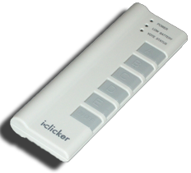
Smallest to Largest?
0xC < 0b1010 < 11
0xC < 11 < 0b1010
11 < 0b1010 < 0xC
0b1010 < 11 < 0xC
0b1010 < 0xC < 11

Slide 9
Abstraction: Base Conversion

Slide 10
Convert FROM decimal TO binary
en.wikipedia.org/wiki/Binary_number#Conversion_to_and_from_other_numeral_systems
E.g., 13 to binary?
Start with the columns
Left to right, is (column) ≤ number n?
If yes, put how many of that column fit in n, subtract column * that many from n, keep going.
If not, put 0 and keep going. (and Stop at 0)
13
2³=8 | 2²=4 | 2¹=2 | 2⁰=1
5
1
1
1
0
1
0

Slide 11
Convert FROM decimal TO hexadecimal
en.wikipedia.org/wiki/Binary_number#Conversion_to_and_from_other_numeral_systems
E.g., 165 to hexadecimal?
Start with the columns
Left to right, is (column) ≤ number n?
If yes, put how many of that column fit in n, subtract column * that many from n, keep going.
If not, put 0 and keep going. (and Stop at 0)
165
16³=4096 | 16²=256 | 16¹=16 | 16⁰=1
5
0
0
0
(10) A
5

Slide 12
Convert Binary ←→ Hexadecimal
Binary → Hex? Easy!
Always left-pad with 0s to make full nibbles, then look up!
E.g., 0b11110 to Hex?
0b11110 → 0001 1110
Then look up: 0x1E
Hex → Binary? Easy!
Just look up, drop leading 0s
0x1E→0001 1110→0b11110
D H B 00 0 0000 01 1 0001 02 2 0010 03 3 0011 04 4 0100 05 5 0101 06 6 0110 07 7 0111 08 8 1000 09 9 1001 10 A 1010 11 B 1011 12 C 1100 13 D 1101 14 E 1110 15 F 1111
☑

Slide 13
Abstraction: Power, Limitations

Slide 14
Abstraction (revisited): Digital Data
A combination of abstractions is used to represent digital data.
At the lowest level all digital data are represented by bits.
Bits can represent anything!
Bits are grouped to represent higher-level abstractions including numbers and characters.
Logical values? 0 → False, 1 → True
Colors? 00 → Red, 01 → Green, 10 → Blue
Characters? 00000 → ‘a’, 00001 → ‘b’, …
Higher-level abstractions such as Internet protocol (IP) packets, images, and audio files are comprised of groups of bits that represent different parts of the abstractions.

Slide 15
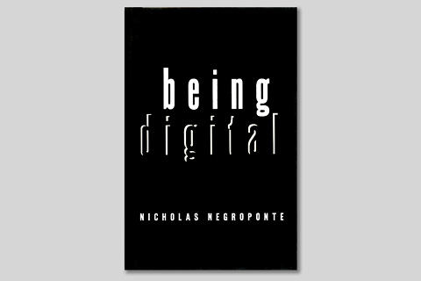
Interpretation of a Binary Sequence…
…depends on how it is used (e.g., as instruction, number, text, sound, or image).
The sequence of bits that represents…
…an instruction may also represent data processed by that instruction.
…a character/letter may also represent a number.
…a color in an image may also represent a sound in an audio file.
(Wikipedia)

Slide 16
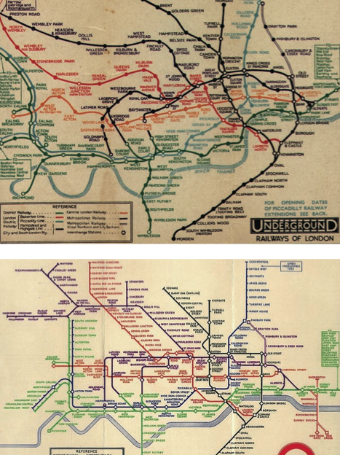
Detail Removal Often Comes At A Cost
en.wikipedia.org/wiki/Binary_number#Conversion_to_and_from_other_numeral_systems
Removing detail isn’t universally a positive thing.
The simplification often takes out the subtle aspects of the original
Cliff notes not always better than novel!
The London Underground 1928 Map & Harry Beck 1933 map.

Slide 17
Overflow and Roundoff
en.wikipedia.org/wiki/Round-off_error
Overflow
When the number of represented things exceeds digits allocated for it.
E.g., Odometer rollover
99999→00000
E.g., Adding 15 + 2 using 4 bits:
0b1111 + 0b10 = 0b1
Roundoff error
When the true real number can’t be stored exactly given the encoding due to the fixed number of bits
E.g., π = 3.14
Sometimes this error accumulates causing problems!

Slide 18

Summary: Abstractions everywhere!
Applications and systems are designed, developed, and analyzed using levels of hardware, software, and conceptual abstractions.
E.g., Mobile apps and systems
E.g,. Web services (both an application and a system)
This course will include examples of abstractions used in modeling the world, managing complexity, and communicating with people as well as with machines.
☑

